Slide 1
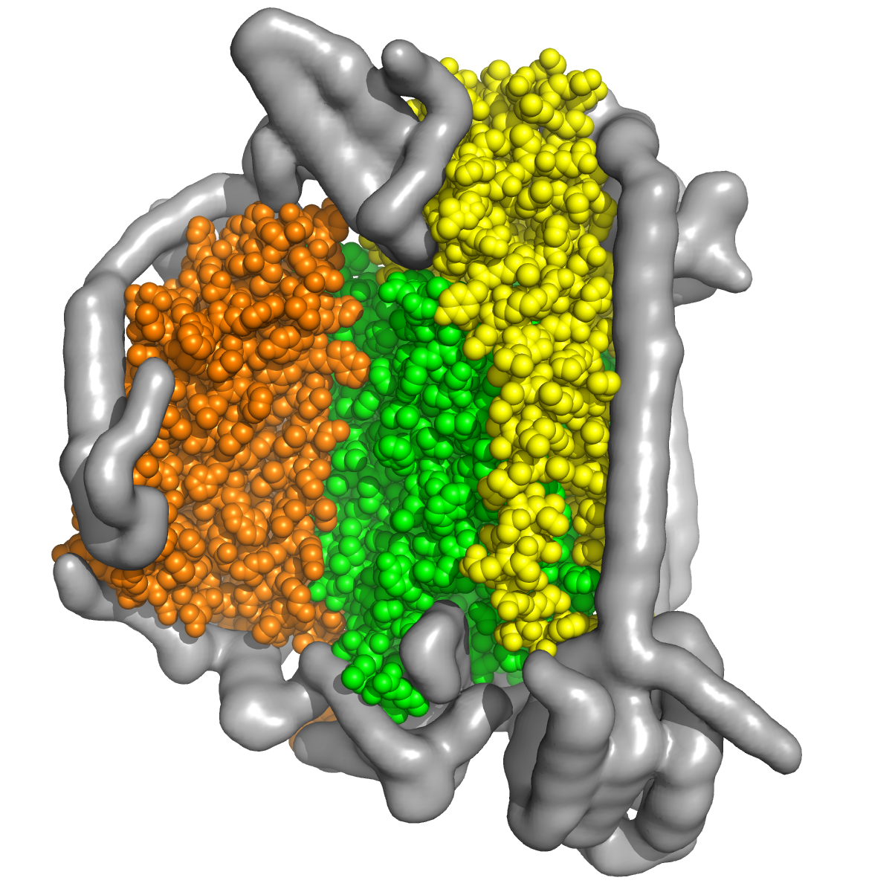
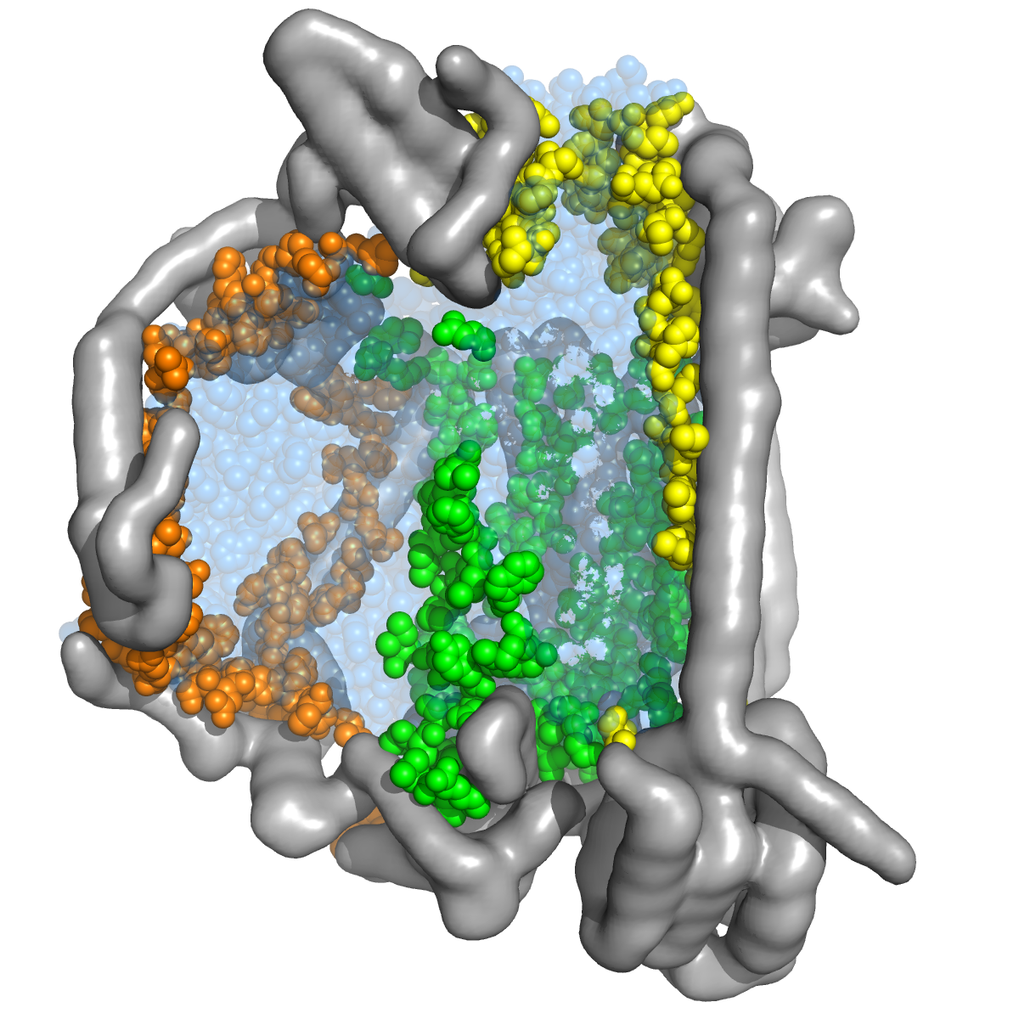
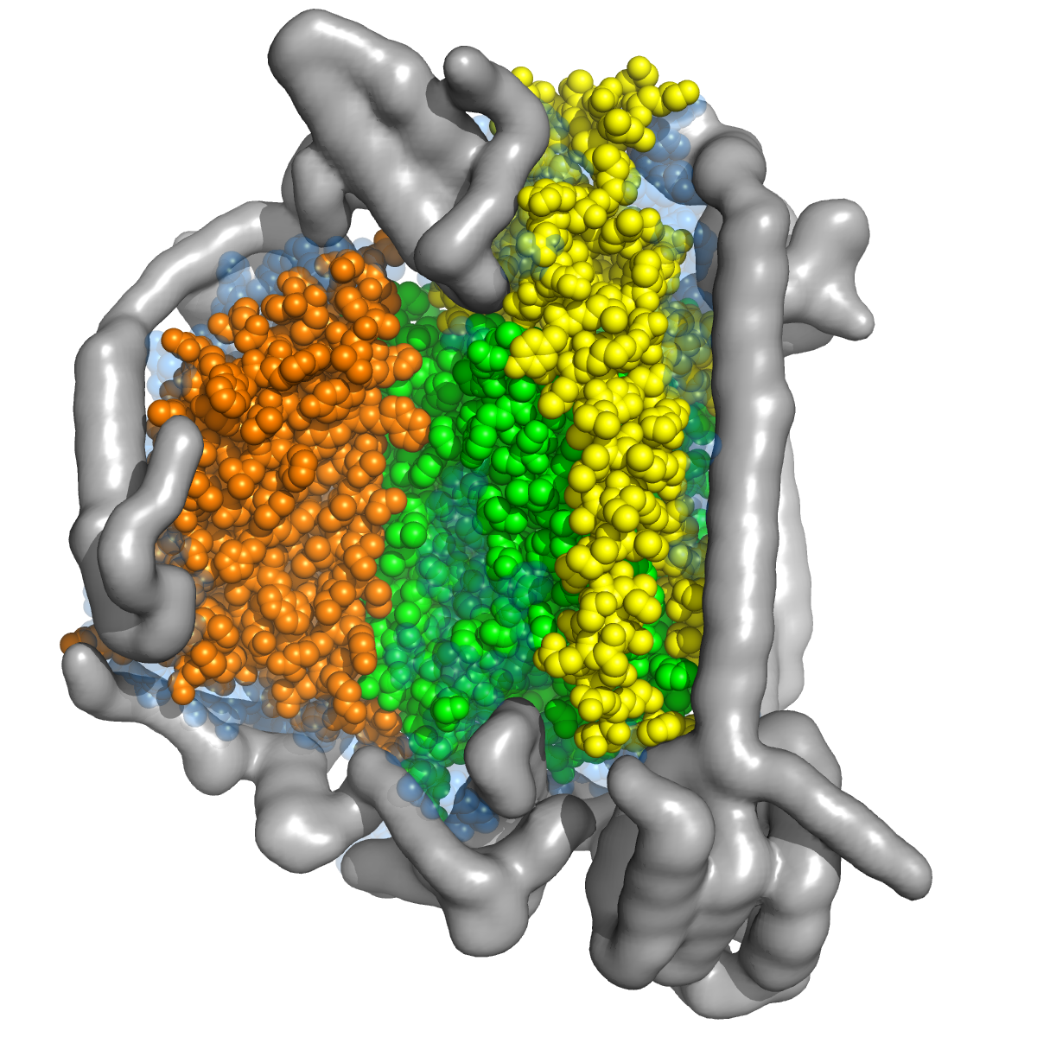
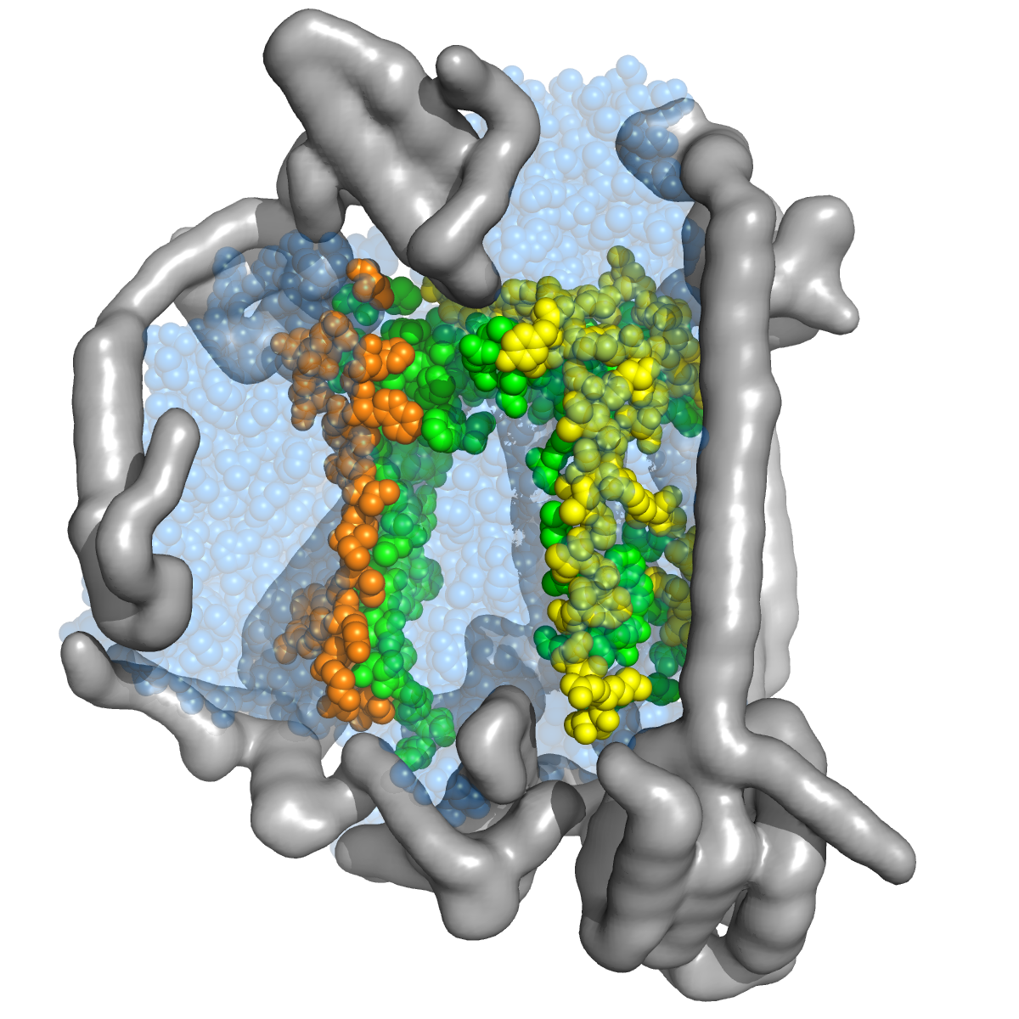
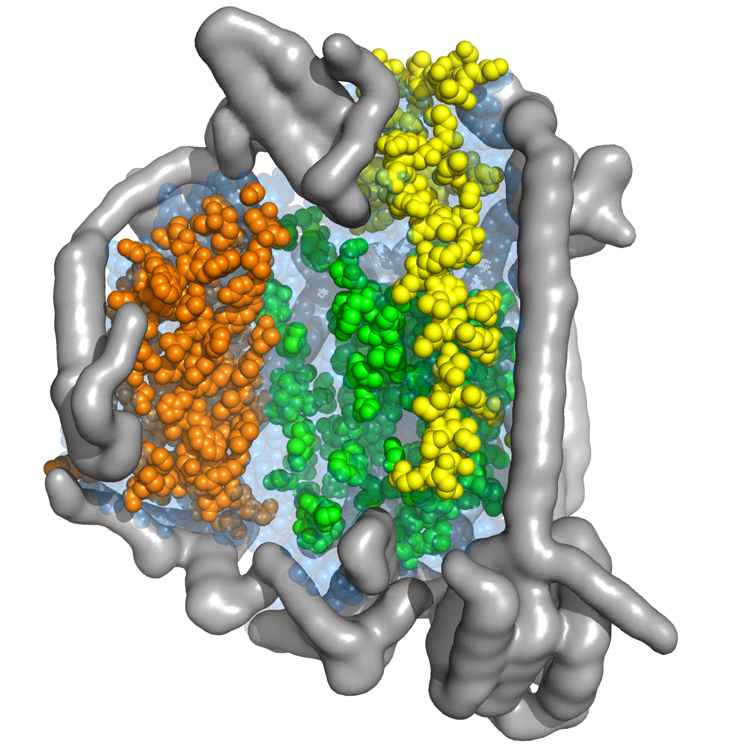
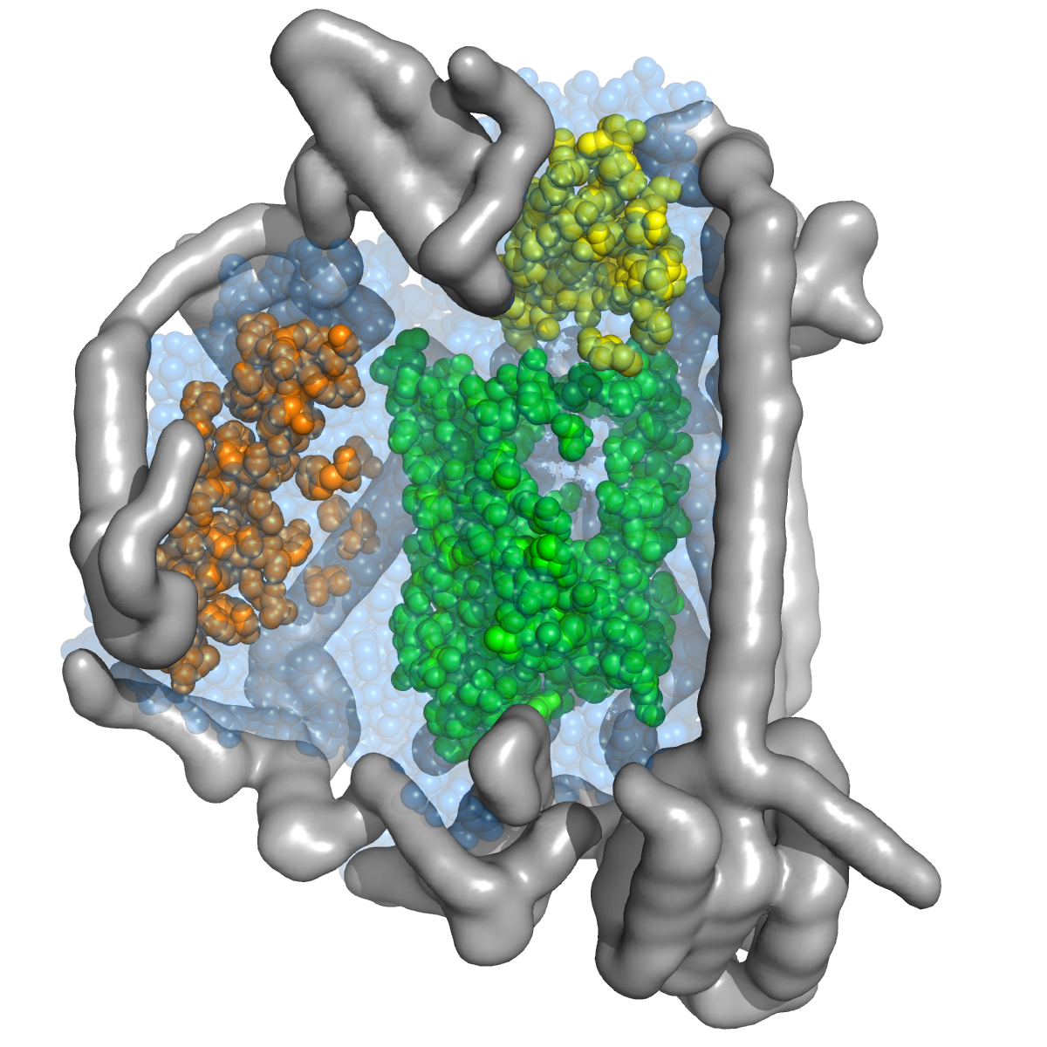
A (COX 1)
B (COX 2)
C (COX 3)
ABC
(a)
ABC_{Contacto mt-nu}
(ABC_{Contacto mt-nu})^{c}
(b)
ABC_{Contacto mt-mt}
ABC_{No Contacto} _{Expuesto}
ABC_{No Contacto} _{Enterrado}

